Slide 1
Introduction to Apache Kafka
Rajeev Gupta
Java Trainer & consultant

Slide 2
What is Apache Kafka?
Apache Kafka is an open-source stream-processing software platform developed by LinkedIn and donated to the Apache Software Foundation.
It has been developed using Java and Scala.
Apache Kafka is a high throughput distributed messaging system for handling real-time data feeds.

Slide 3
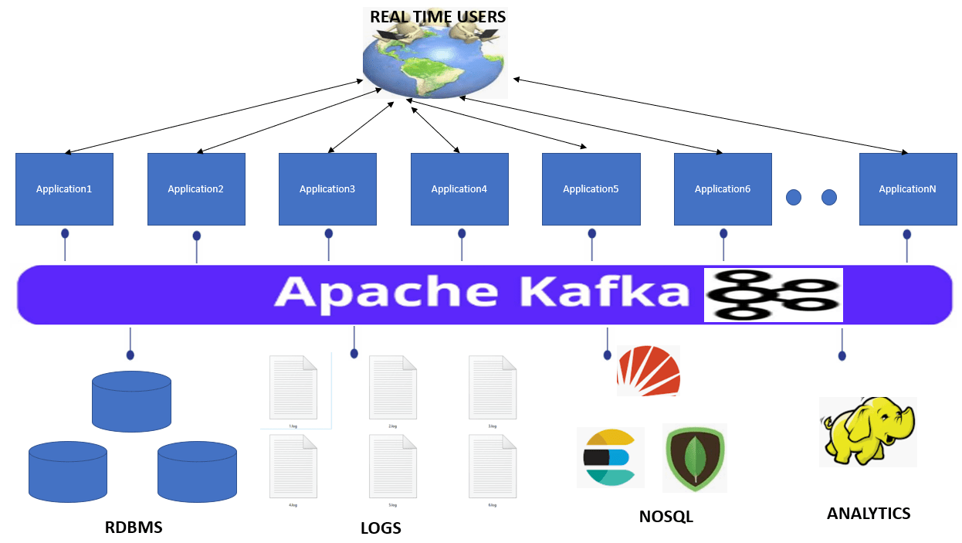
Traditional Messaging vs SystemApache Kafka

Slide 4
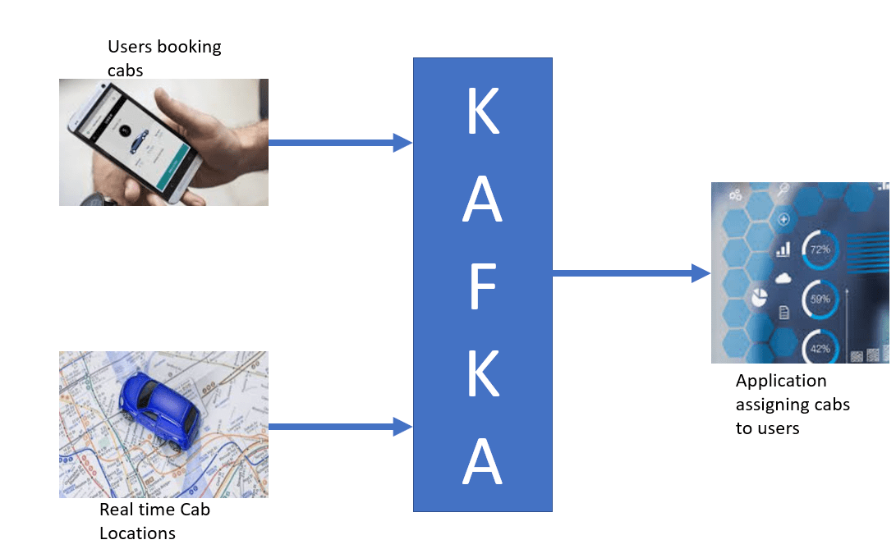
Apache Kafka Usages
Real time example of Apache Kafka is Uber cab booking service. Uber makes use of Kafka to send User and Cab information to Uber Cab Booking System.

Slide 5
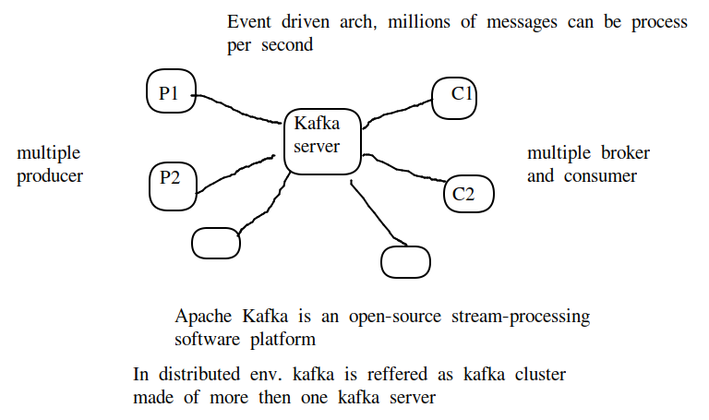
What is Apache Kafka?

Slide 6
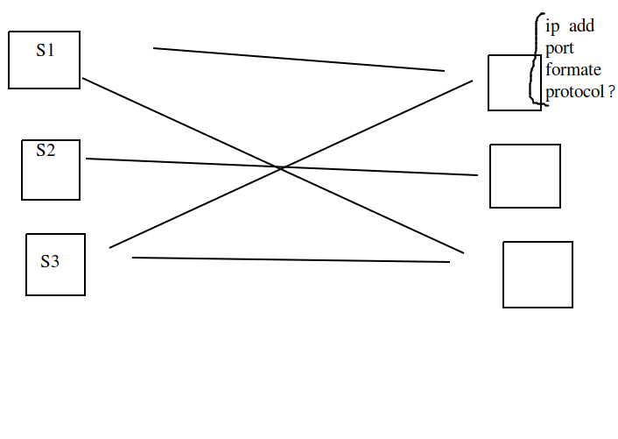
Need of Apache Kafka?

Slide 7
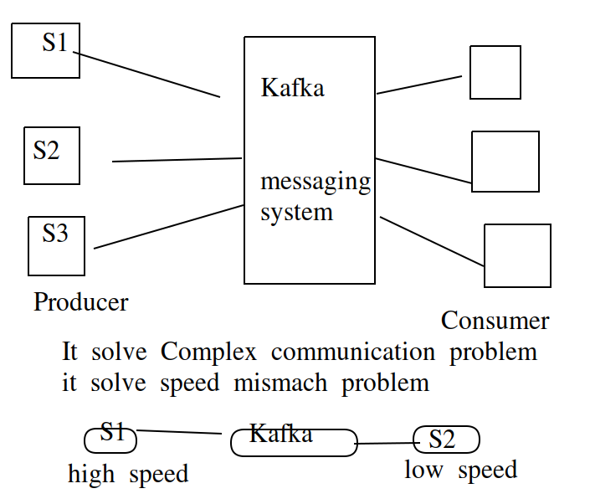
Decoupling data processing pipeline

Slide 8
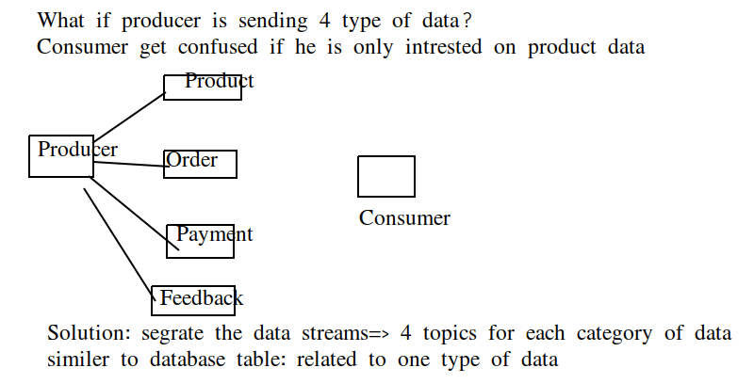
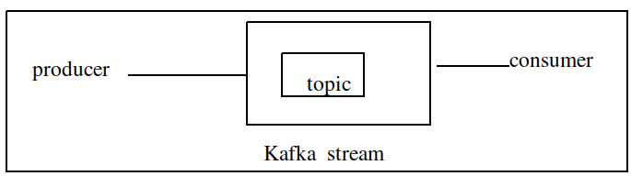
What is topic

Slide 9
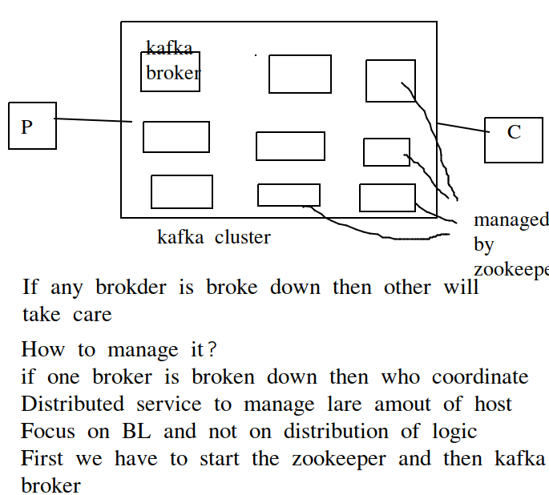
Scalability and fault tolerence(Zookeeper)
Horizontal scaling: add new kafka broker if required

Slide 10
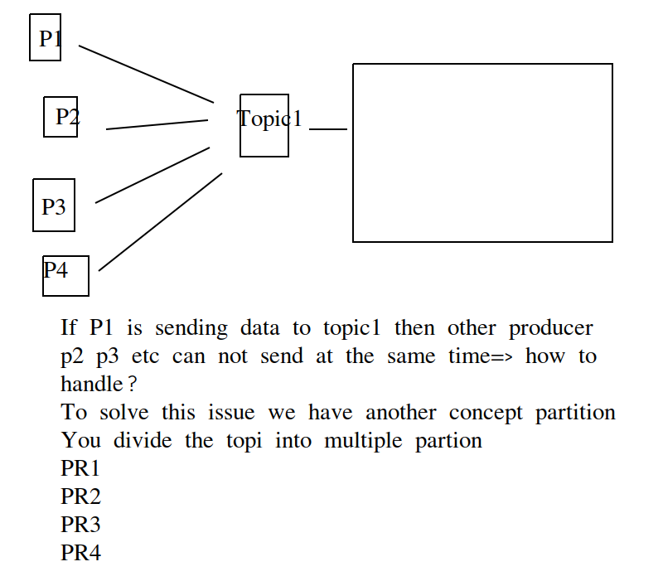
Problem of parallelism

Slide 11
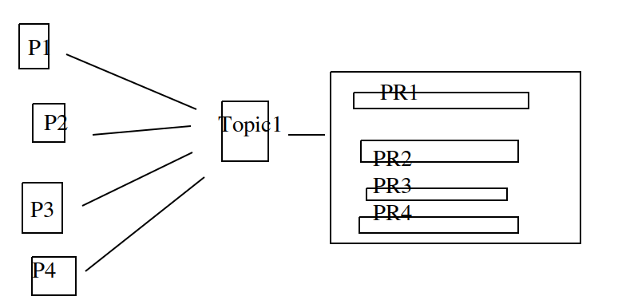
Problem of parallelism: Partitions

Slide 12
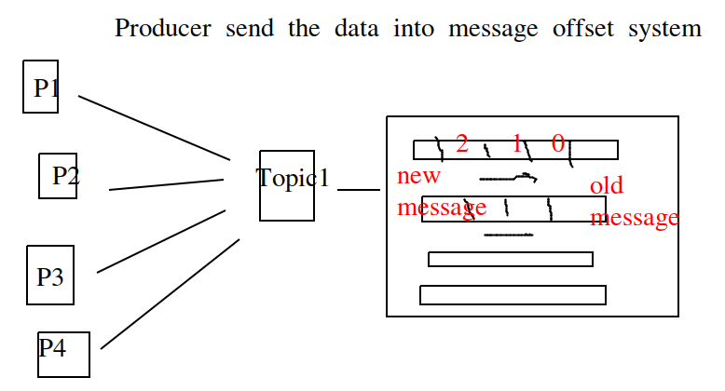
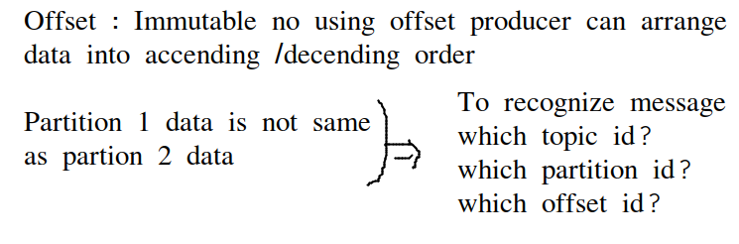
Partitions offset

Slide 13
Consumer Group
We have only one consumer how data processing happens
You create many consumer and connect one partion
We can get all the data into one shot from 4 partitions, that is called consumer group
Consumer group: single logical using they can share the work

Slide 14
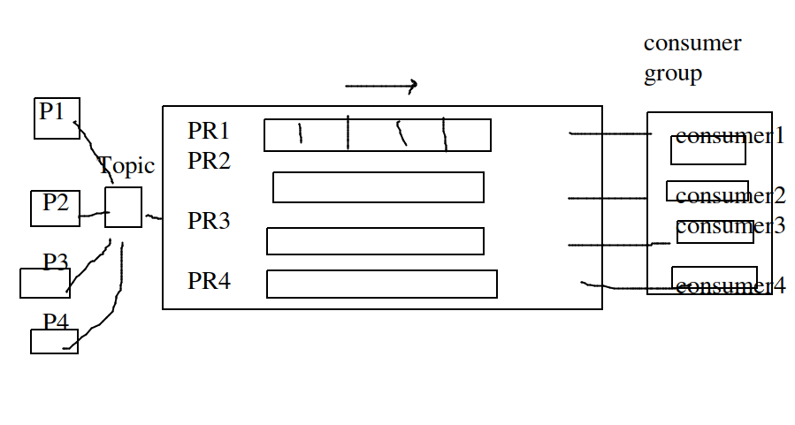
Consumer Group

Slide 15
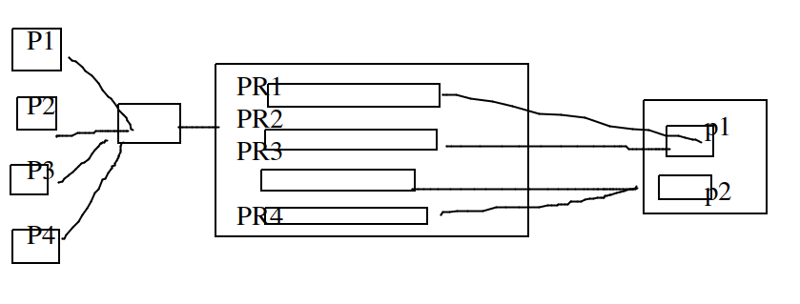
Consumer Group
Case I: if only 2 consumer is there in consumer group
Case 2: if 4 consumer is there , each one take data from each partition
Case 3: if we have 5 consumer group, 1 will be idel
Case 4: if one consumer then all data send to that

Slide 16
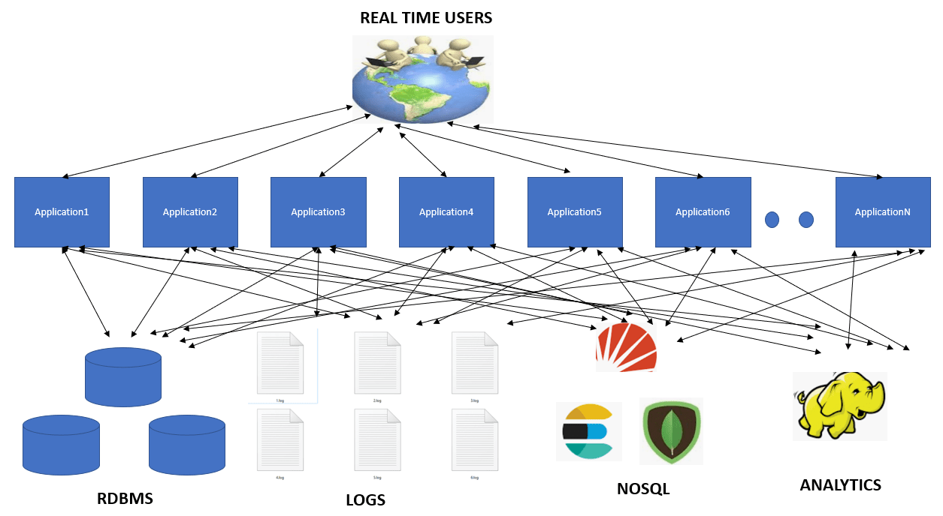
What is need of Apache Kafka?
Complex web of applications involving point to point data movement. This involves moving large amount of data from one point to another.

Slide 17
Replication factor
Consider topic1 with 4 partition, then not all partition go into the broker
Partition will be distribtued into multiple broker
What if broker 2 is gone?
How to solve the issue => replication copy
If RF =3 then T1P1 should be replicated to 3 places in different brokers
Although T1P1 is at 3 places one of them is called leader
Kakfa zooker send data to the leader and then leader distributed/ replicate to others

Slide 18
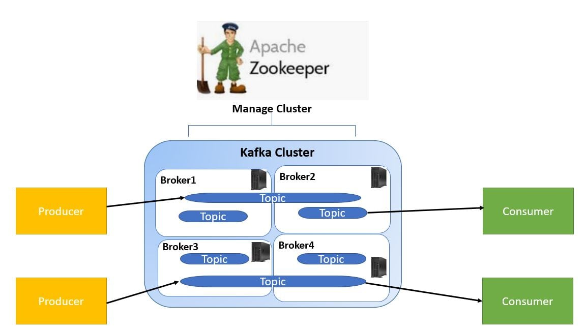
Zookeeper

Slide 19
Zookeeper
To manage the cluster we make use of Apache Zookeeper. Apache Zookeeper is a coordination service for distributed application that enables synchronization across a cluster.
Zookeeper can be viewed as centralized repository where distributed applications can put data and get data out of it.
It is used to keep the distributed system functioning together as a single unit, using its synchronization, serialization and coordination goals, selecting leader node.

